Slide 1

The 11th of December
I’m sad I’m fine So so

Slide 2
A tongue twister
Hickety, pickety, my black cat
Likes to sit in my blue hat.
[I], [æ], [k], [t]

Slide 3



Slide 4
What do people usually do on this holiday?

Slide 5
Do you know the symbols of this holiday?

Slide 6
Who gives the city of London a Christmas tree every year?

Slide 7
Where does the Christmas tree stand?

Slide 8
What is Boxing day?
What do people usually do on that day?

Slide 9
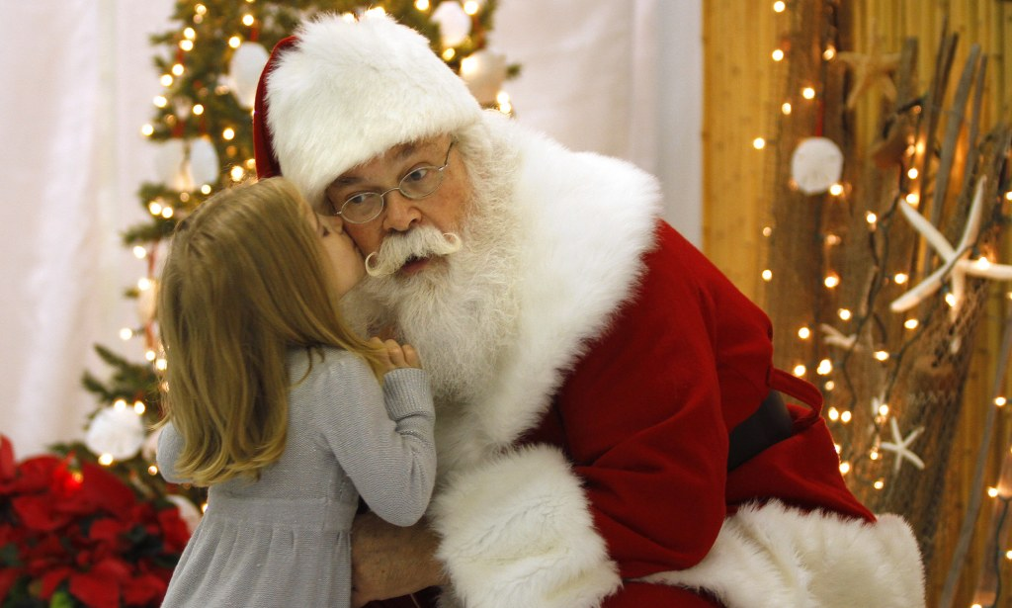
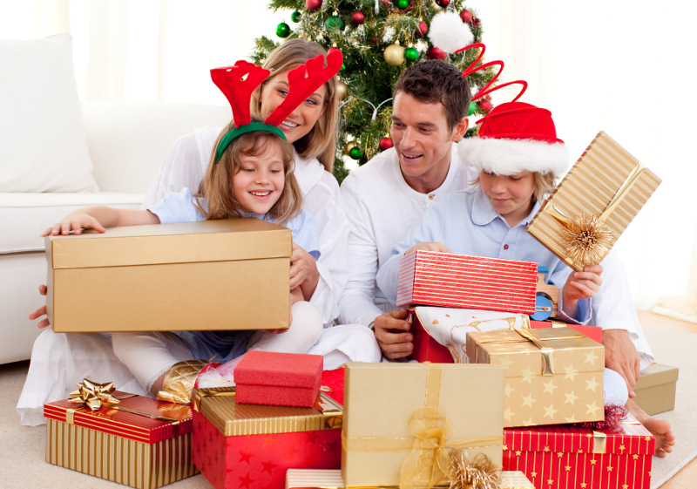
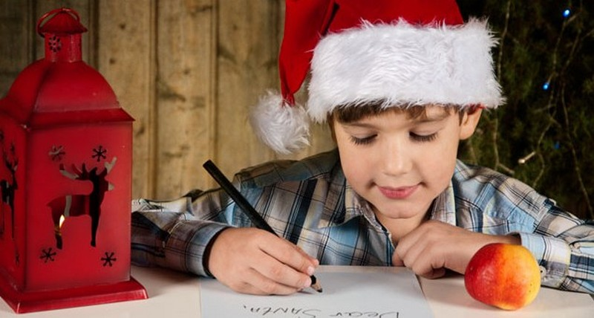
What can you see in these pictures?

Slide 10


London, The UK
December, 11th
Dear Santa!
How … you? My name … Betty. I … very glad about presents. Thanks a lot. I … good at studying .My parents … proud of my success. Now I … writing this letter to you and my parents … decorating our Christmas tree. I would like them to give me a small puppy as a present! What … your favourite music? What … you favourite book?
Lots of love.
Betty.

Slide 11

London, The UK
December, 11th
Dear Santa!
How are you? My name is Betty. I am very glad about presents. Thanks a lot. I am good at studying .My parents are proud of my success. Now I am writing this letter to you and my parents are decorating our Christmas tree. I would like them to give me a small puppy as a present! What is your favourite music? What is your favourite book?
Lots of love.
Betty.

Slide 12
Test yourself:
1. The structure of the Present Continuous is:
a) Vs
b) to be +Ving
2. The Present Continuous expresses (выражает):
the “process” (процесс)
“repeated action” (повторяющееся действие)

Slide 13
Карта успеха
Зеленый – хорошо работал(а);
Синий – старался(лась), но не все получалось хорошо;
Красная – сегодня не получилось, но в следующий раз все получится.
1. Pictures and Betty’s letter.
(выбери свой цвет и наклей)

Slide 14
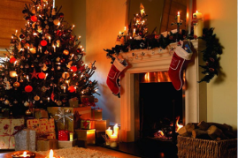
- What would you like to get on Christmas?
I’d like to get a………. .

Slide 15
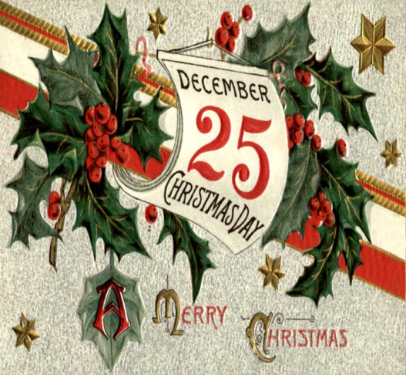
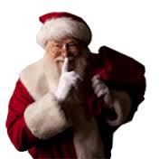
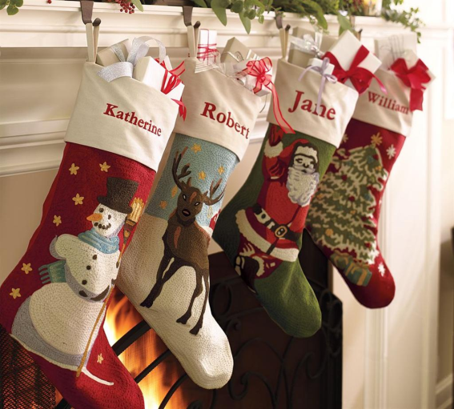
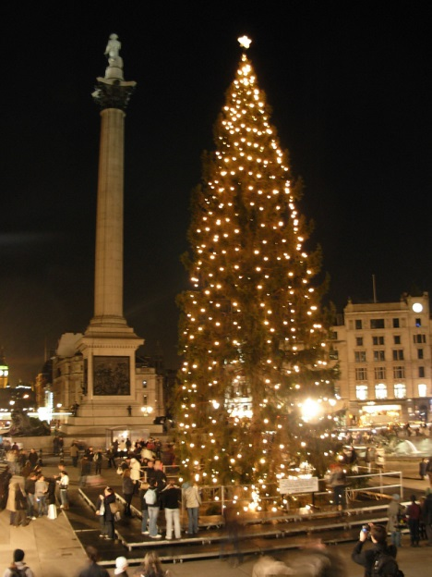
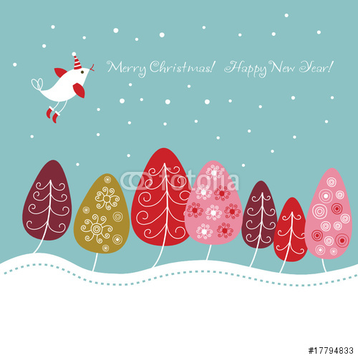
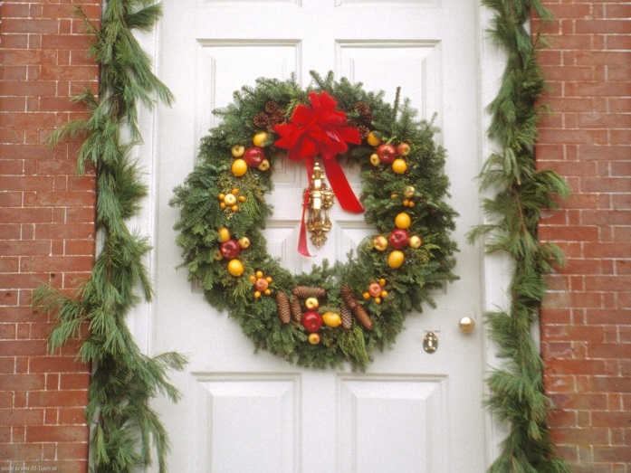
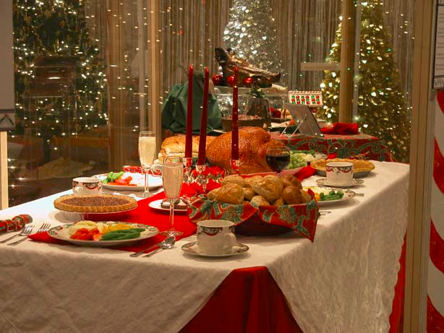


Slide 16
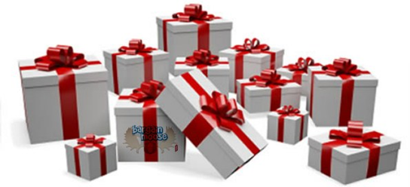
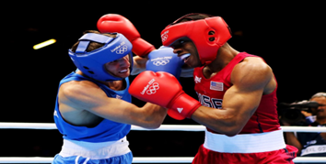
Test yourself:
1. What is X-mas?
a) Christmas
b) New Year
2. The old legend of stockings was about a poor man and his three daughters, wasn’t it?
3. For X-mas dinner people eat chicken, rice and sweets, don’t they?
4. Boxing day means…
a) b)

Slide 17
Карта успеха
Зеленый – хорошо работал(а);
Синий – старался(лась), но не все получалось хорошо;
Красная – сегодня не получилось, но в следующий раз все получится.
2. Christmas symbols.
(выбери свой цвет и приклей)

Slide 18


Christmas is magic
Christmas is fun
Merry Christmas everyone!

