Slide 1

The 23rd of November
I’m sad I’m fine So so

Slide 2
The 23rd of November
[k] – cockerel, car, cook, cake, truck;
[s] – city, sit, socks, cinema, soup;
[Λ] – cup, truck, summer, bus.
Clap your hands when you hear:
[k] – cockerel, socks, bus, truck, car.
[Λ] – cup, cook, sit, bus, summer.
[s] – soup, car, cinema, summer, cup.

Slide 3
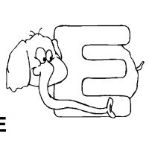
Ee [i:]
[ɪ:]
Pete she he
bee tree
three meet
er – [3:] her, term,herd
[e]
Ben ten
tent web
bell belt

Slide 4
Let’s read
Сравните: run - ran
lump - lamp
hut - hat
but - bat
rule - run rude - rum
true - trust
due - just rub - rib
but - bit
must - mist sun - sin

Slide 5
Vv [vi:]
[v] move violine wolves

Slide 6
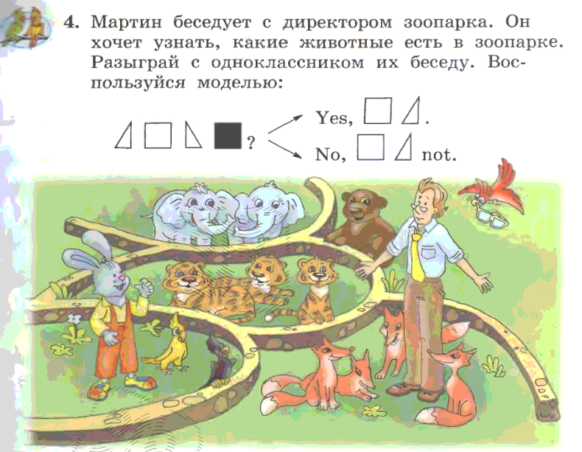
Домашнее задание

Slide 7
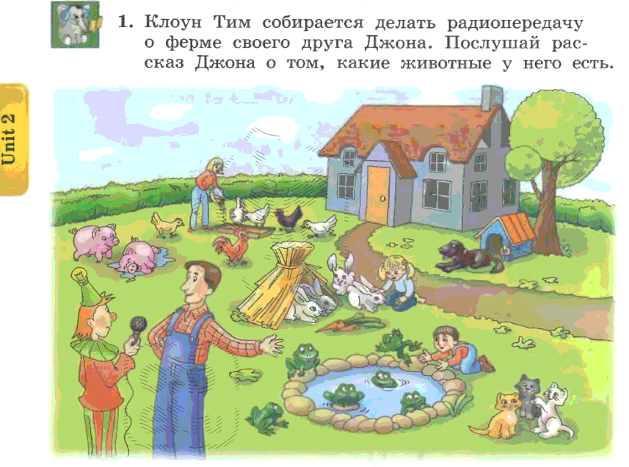
Notes:
Скажи сколько животных на ферме?
Раcспроси Джона о его ферме. Have you got…?
Расскажи о фермере Джона, так словно это твоя ферма. I have got…

Slide 8
Make plural from singular:
Cat –
Dog –
Fox –
Parrot –
Crocodile –
Frog –
Match –
Fish -

Slide 9
Д/з:
Подготовиться к с/р по множественному числу;
РТ- стр.19-20;
Упр. 6 стр. 43

